Slide 1


Scientific Calculator — Project Overview
Developed by: Dhiraj Sharma
IDE: Visual Studio Code
Project: Nexthike IT Solutions
Tone: Technical, concise. Audience: Python developers and students familiar with GUI concepts.

Slide 2
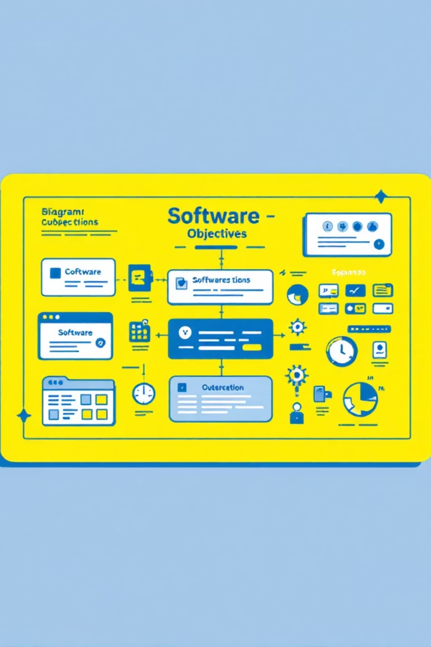
Project Objectives & Key Features
Learn Tkinter
Arithmetic ops
Scientific functions
Hands-on experience building windows, frames, widgets, and event loops.
Implement add, subtract, multiply, divide with correct precedence handling.
Integrate math module functions: sin, cos, tan, log, sqrt, power.
Dynamic UI
Dual-Mode Interface
Enable runtime layout switching and window resizing between modes.
Seamlessly toggle between Normal and Scientific calculator modes.

Slide 3
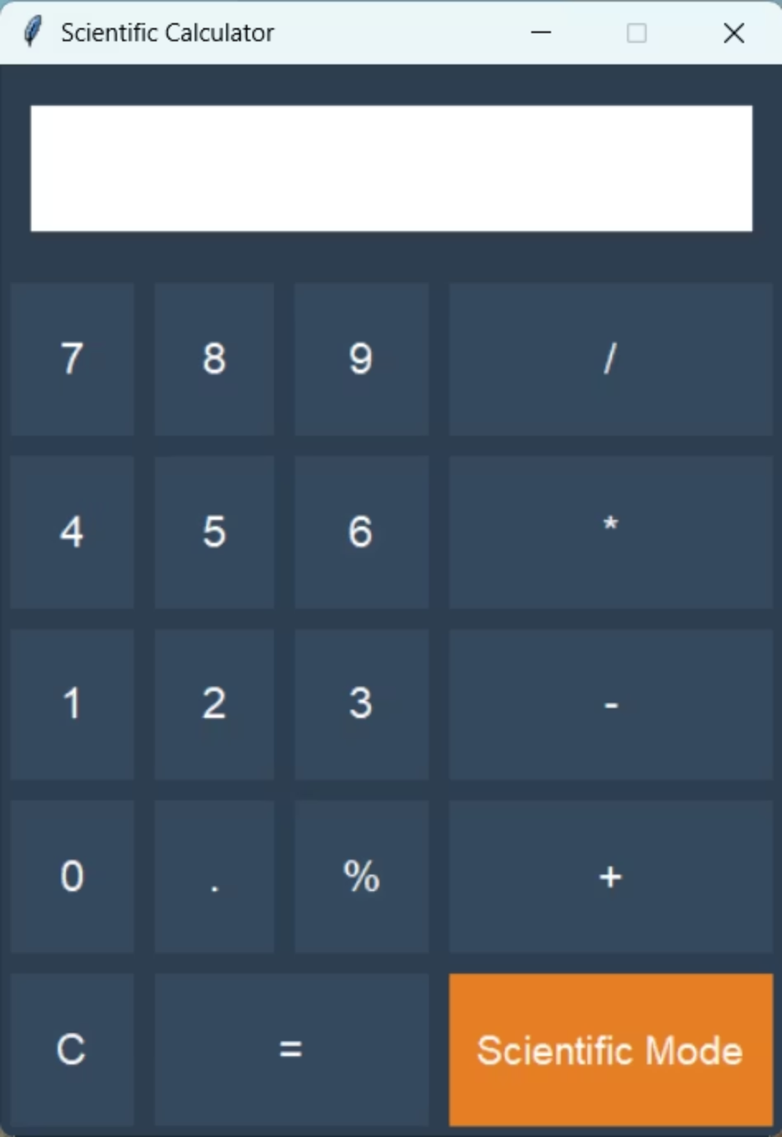
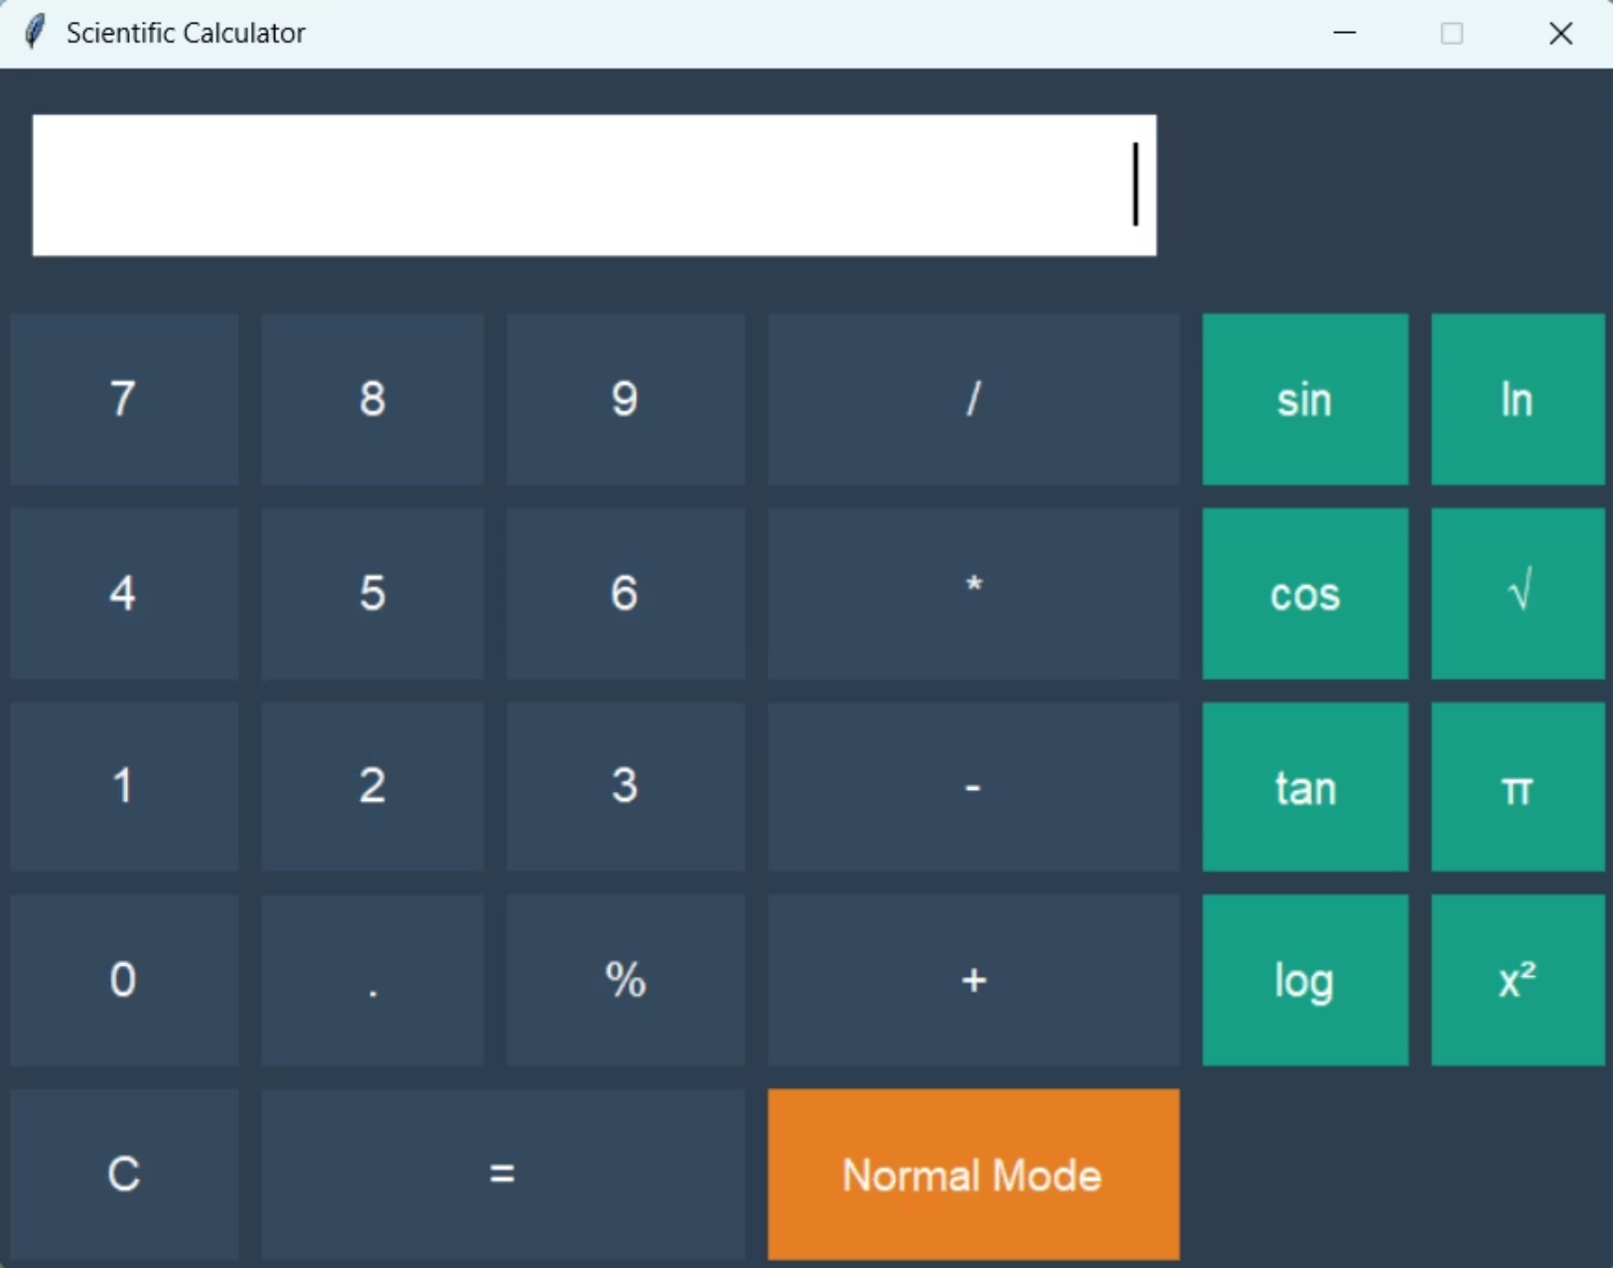
Scientific Mode Calculator
Normal Mode Calculator

Slide 4
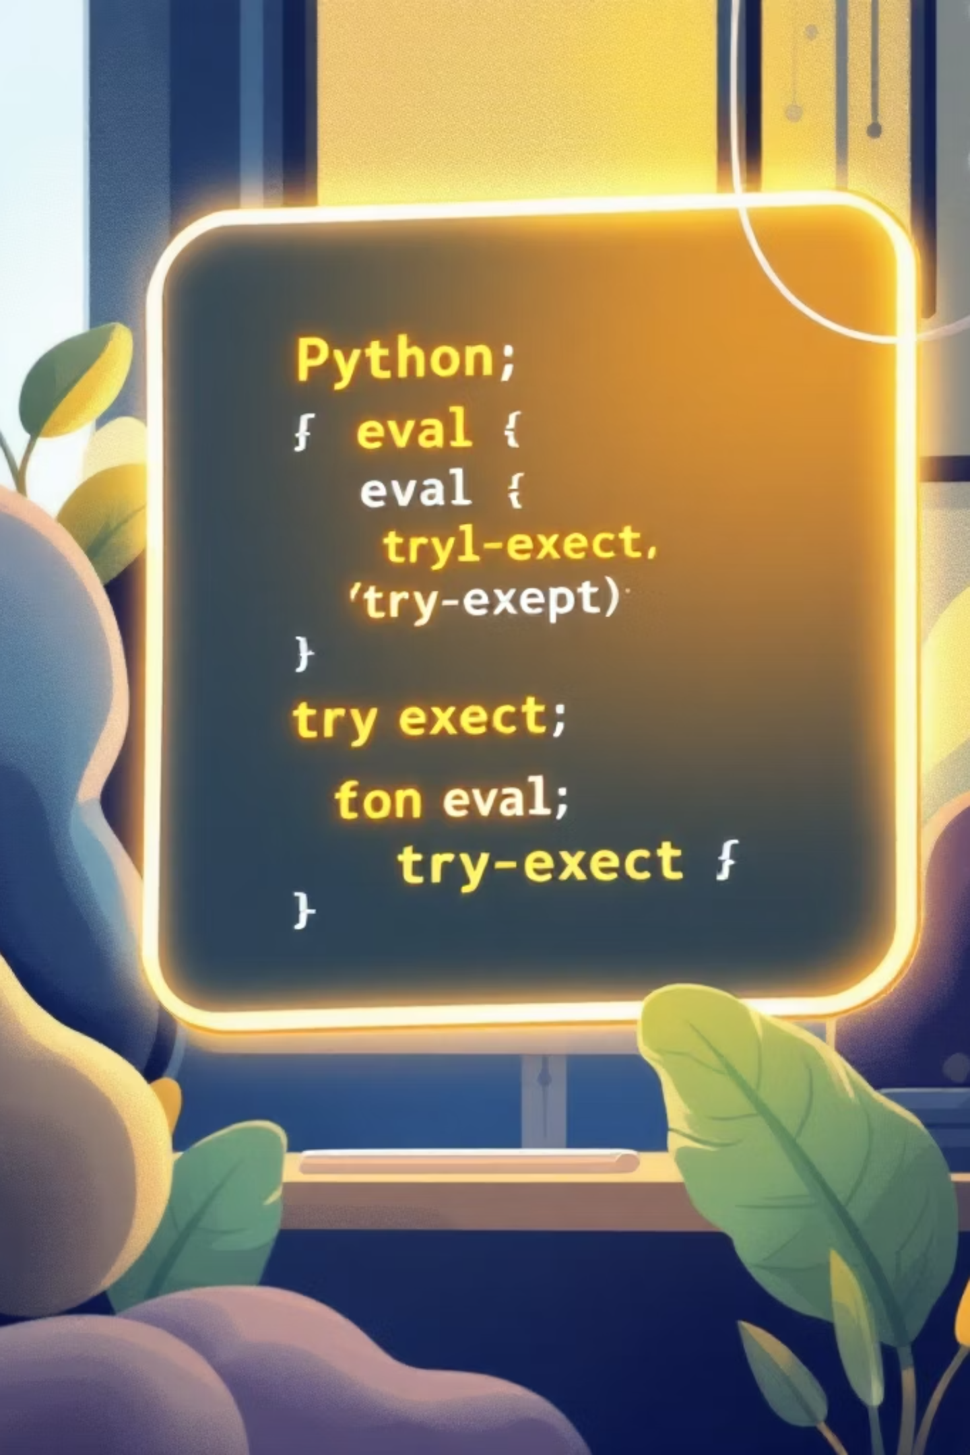
How the Calculator Works
Input from buttons or the keyboard is stored. When '=' or Enter is pressed, the expression is calculated, and the result is shown.
State management
Handles input and output with a string variable, updated by button presses.
Evaluation
Calculates results from expressions, supporting math functions safely.
Error handling
Catches common errors like syntax or division by zero, showing friendly messages.

Slide 5
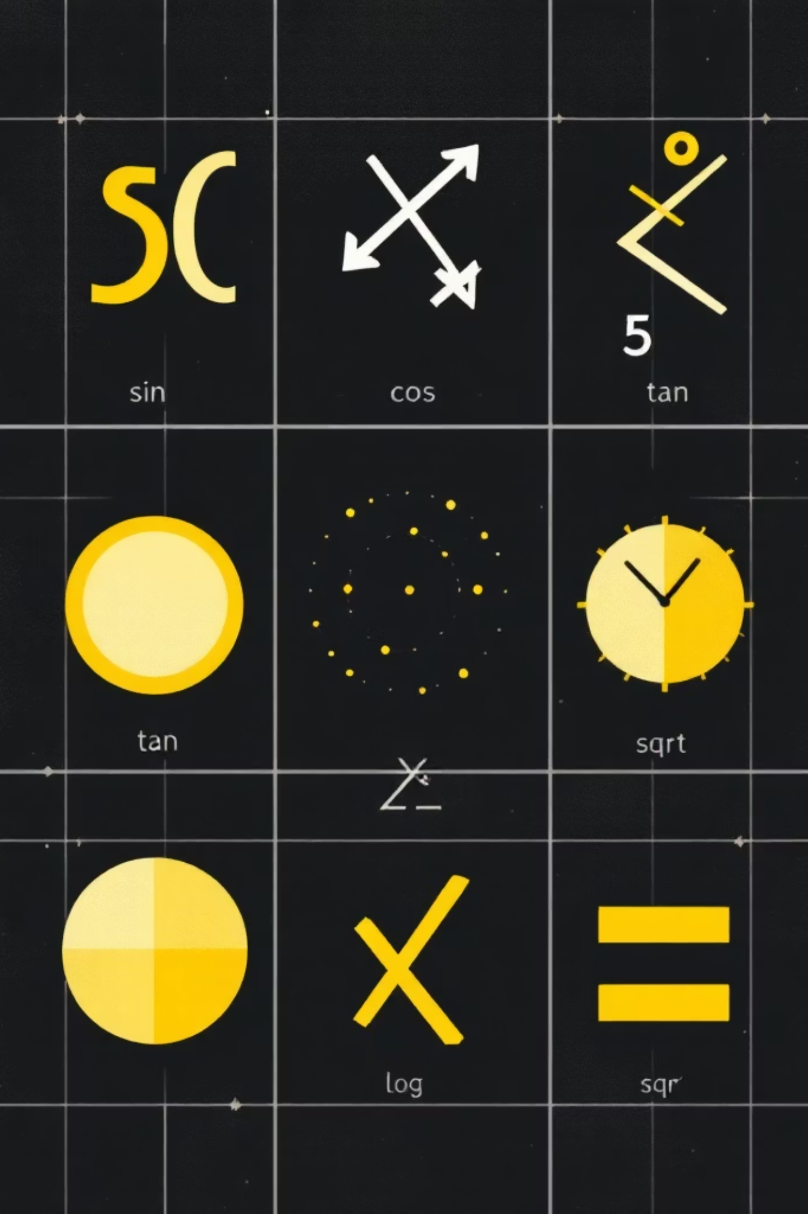

Scientific Button Functionality
Trigonometric
Provides sin, cos, and tan functions for angle-based calculations.
Logarithmic & Exp
Includes log (base 10), natural log (ln), and exponential functions.
Power & Roots
Offers square root (sqrt) and general power (x^y) operations.
Mode Toggle
Switches the scientific panel display without affecting ongoing calculations.

Slide 6


Conclusion & Next Steps
The dual-mode calculator successfully combines basic arithmetic and scientific functions with a responsive Tkinter UI. Key achievements: dynamic layout switching, keyboard integration, robust evaluation and error handling.
Improvements
Extensions
Input sanitization, unit conversion tools, and memory functions (M+, M-, MR).
Persist history, add plotting panel using matplotlib, or port UI to PyQt for advanced styling.
Theme accent: #FFE14D used across layouts for emphasis and cohesion.

